Slide 1

Market basket ANALYSIS PROJECT
M.K.SUGANTHE RAMYA

Slide 2
Agenda
Product Overview
Understanding the data
EDA
Univariate, Bivariate and Multivariate Analysis
Data Visualization
Data Preparation
Data Processing
Data Cleaning
Market Basket analysis
Support
Confidence
Lift
Association Rules Algorithms
Business insights
Basket based analysis
Insights for better sales
The project involves conducting a thorough analysis of Point of Sale (POS) Data for providing recommendations through which a grocery store can increase its revenue by popular combo offers & discounts for customers.

Slide 3
EDA Summary of the dataset
This Dataset contains transactional data of Grocery Store .Agenda of this project is Market Basket analysis
Summary of the data, EDA, Market Basket analysis is analyzed using Jupyter Notebook (Python)
Given Dataset Contains 3 columns and 20641 rows
There are no null values
There are 4730 duplicates. There are not dropped because one Transaction can contain many number of same Products
For e.g., Order_id 1138 contain 3 sodas. Customer Purchased 3 sodas in one order. So, its Important not to drop the duplicates
Product column contains 37 unique products

Slide 4
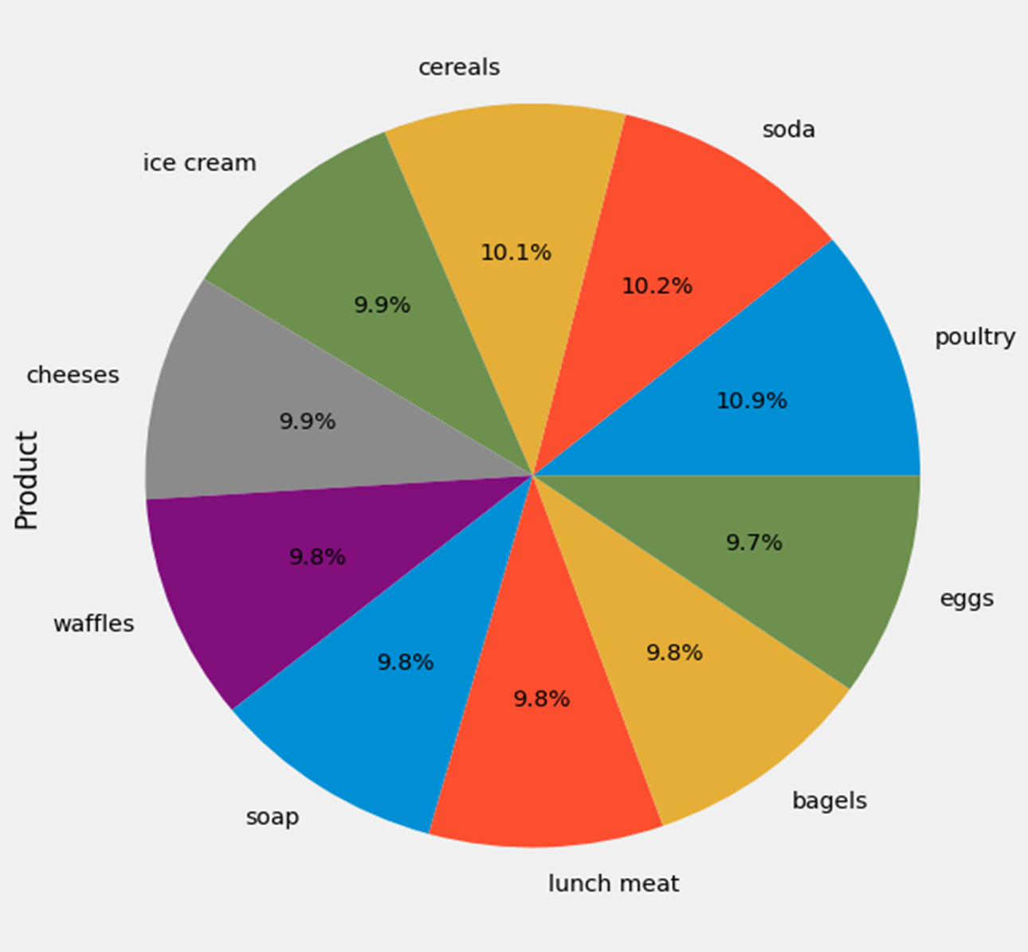
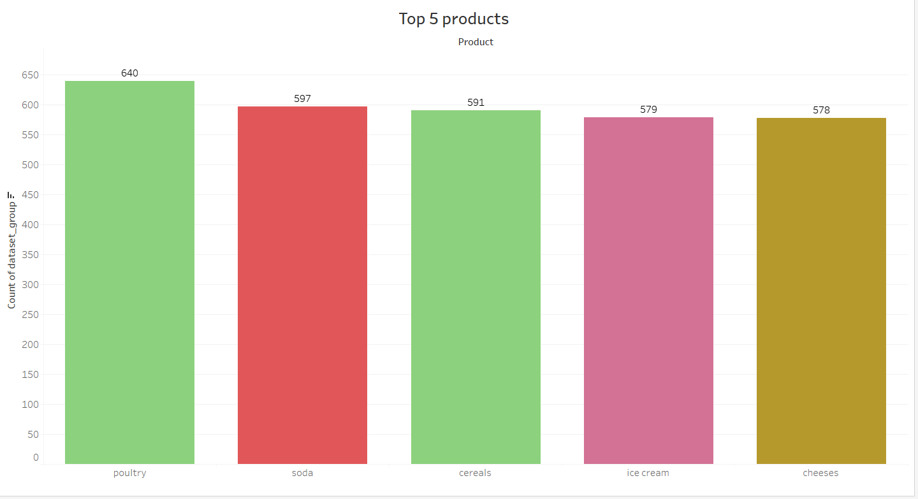
Univariate Analysis
frequency of most popular products
Poultry is frequently sold product
Top 5 products are Poultry, Soda, Cereals, ice cream and Cheese
Most of the products are sold
Least selling product is hand soap

Slide 5
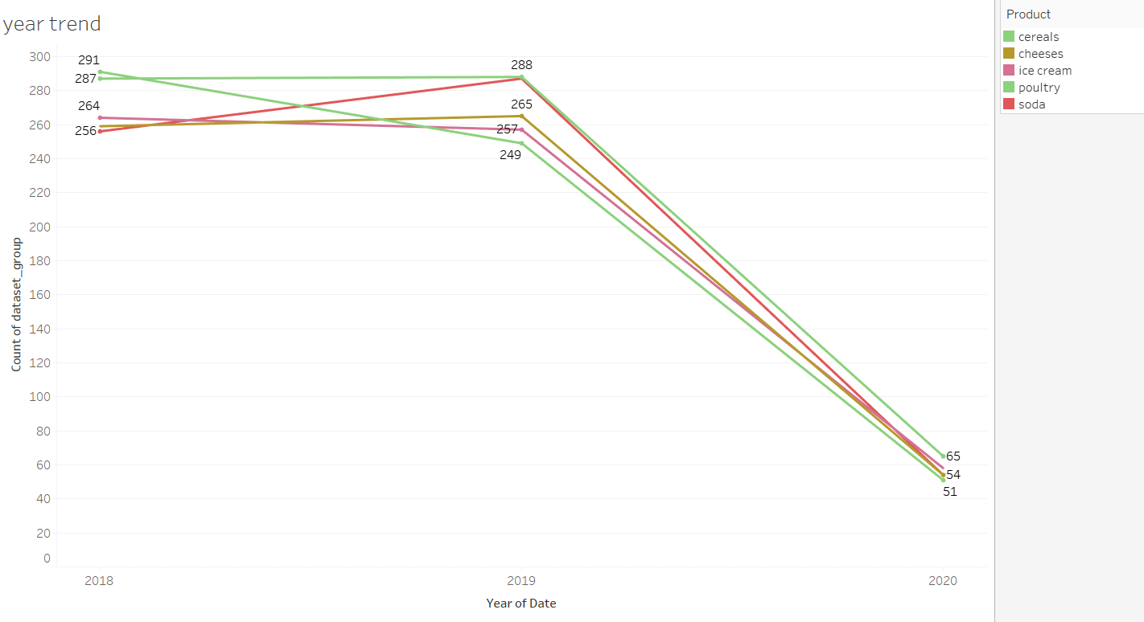
Yearly product transaction Trends
Yearly trend
Yearly Product Transaction Analysis
In 2018 and 2019 ,All Around the year products are sold. But, in the year 2020, only first Quarter transaction are provided, so it showing downward trend.
In the year 2018, Cereals is highest selling product, Second Highest selling product is poultry and Flour is third highest selling product
In the year 2019, Poultry is highest selling product, Second Highest selling product is soda and dishwashing liquid is third highest selling product
In the year 2020, Dinner rolls is highest selling product, Second Highest selling product is Poultry and pork is third highest selling product
Yearly trend of Top 5 product

Slide 6
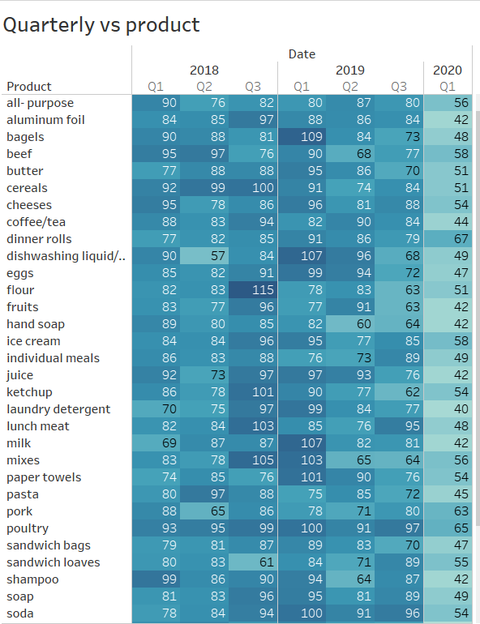
Quarterly product transaction Trends
Quarterly product transaction Trends
Third Quarter of 2018, Flour, mixes and lunch meat had more transactions
First Quarter of 2019, bagels, dishwashing liquid and milk had highest transaction

Slide 7
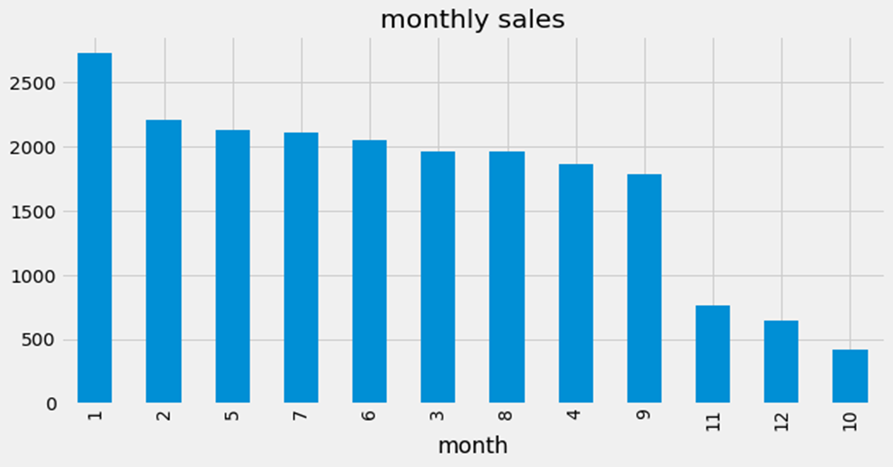
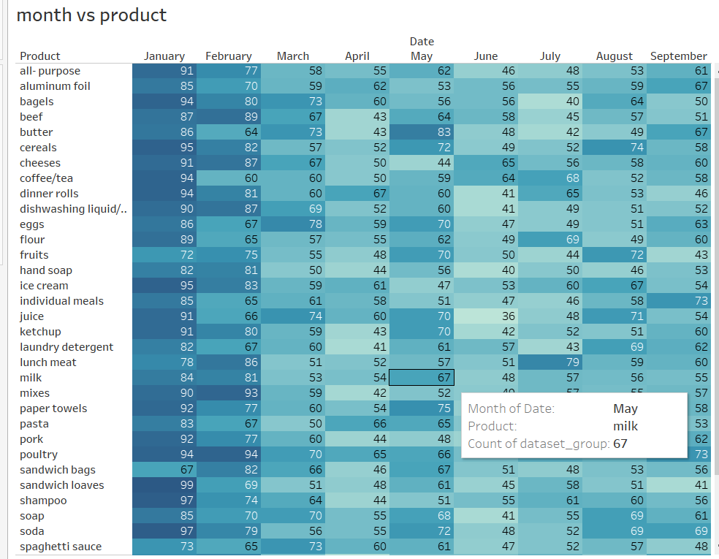
monthly product transaction Trends
Monthly Product Transaction Analysis
In the month of January ,Product transaction is at peak
In the month of October , very low product transaction noted
Sandwich loaves, Shampoo, soda, Cereals, Poultry are highest selling products

Slide 8
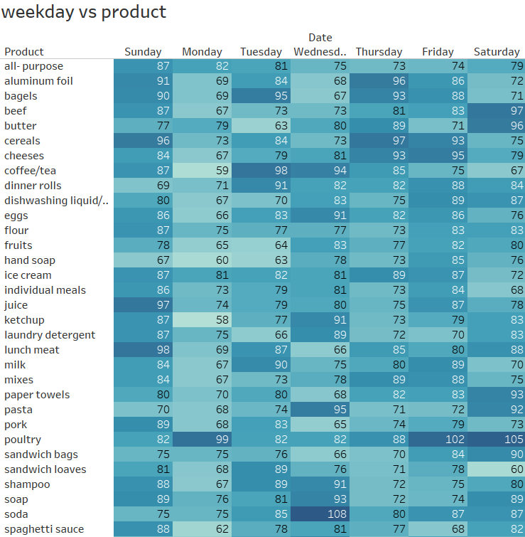
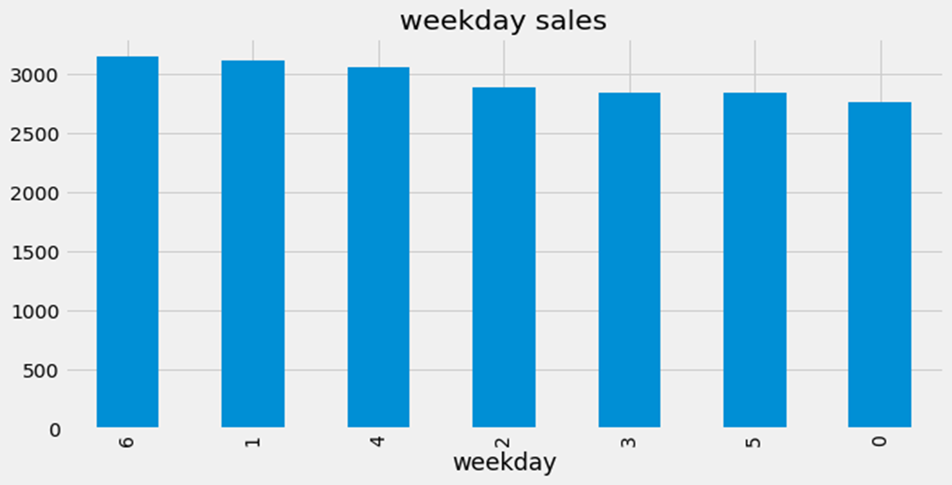
weekday Product transaction Trends
weekday Product transaction Analysis
Highest transaction happens on Sunday
Lowest transaction happens on Monday
Lunch meat has highest transaction

Slide 9
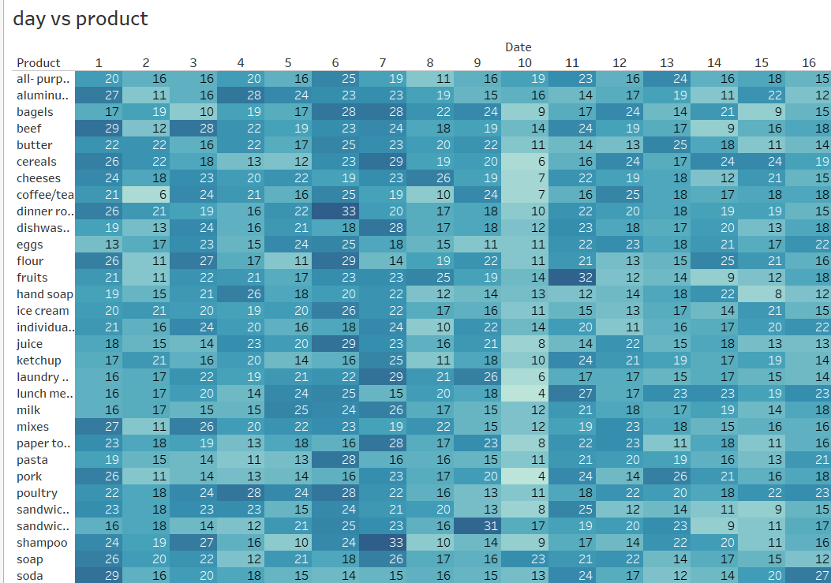
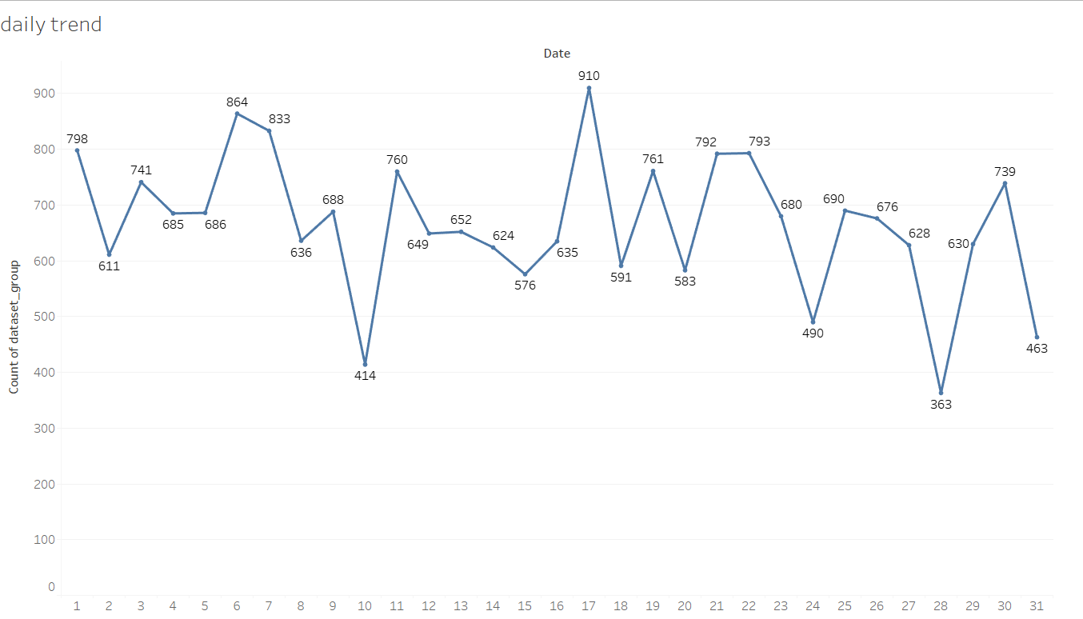
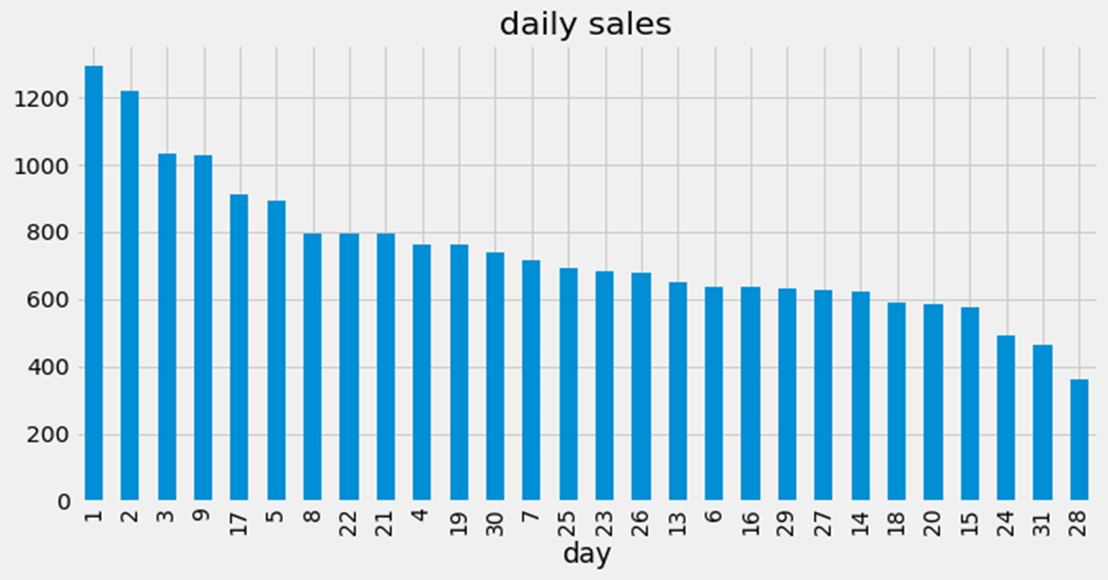
daily Product transaction Trends
Daily Product transaction Analysis
Highest transaction happens on first day of the month
Lowest transaction happens on 28th day of the month

Slide 10
Market basket analysis
Association Rule Mining
Association Rule Mining is used when you want to find an association between different objects in a set, find frequent patterns in a transaction database, relational databases or any other information repository
A typical goal of Market Basket Analysis is to provide a set of association rules in the following form:
Support
It measures the frequency of the association rule in the data.
Confidence
Confidence measures how strong an association rule is.
Lift
Lift is the ratio of confidence to expected confidence.
Market Basket Analysis is a technique that looks for combinations of products in purchases. Most importantly, its basis is that customers who buy a particular group of products are more or less likely to buy another group.
Market Basket Analysis is not the only analytics technique used by recommendation engines.
Customer-based
Item-based
IF [antecedent] THEN [consequent]
Support = Freq(X,Y)/N

Slide 11
Association Rules Algorithms
The most famous algorithm generating these rules is the Apriori algorithm.
The Apriori algorithm is designed to operate on databases containing transactions. For example, items bought by customers.
Firstly, it identifies common individual elements in the dataset. Secondly, it extends the set by adding more and more, if they appear often enough. Afterward, it calculates the “Support” and “Confidence” of each rule, making it possible to examine them according to their importance.
Many programming languages include the Apriori algorithm as a package.
For this dataset, I used Apriori algorithm in jupyter Notebook (Python)
It is helpful to set thresholds for support and confidence when executing the Apriori algorithm.
The association rules with higher lift, confidence, and support are the strongest

Slide 12
Market Basket Analysis
Once you run the algorithm and generate the association rules, the result looks like this:

Slide 13
What You Get out of Market Basket Analysis
The association rules with higher lift, confidence, and support are the strongest. Therefore, they are the ones you should deploy to the recommendation engine and use to determine store layout, promotions and cross-selling strategies.
Inference of Market basket analysis for the given Transaction Dataset
The support value for the first rule is 0.055312 . This number is calculated by dividing the number of transactions containing pasta, paper towels, ice cream, eggs by the total number of transactions.
The confidence level for the rule is 0.336898 , which shows that out of all the transactions that contain both pasta and paper towels’, 33.6 percent contain ‘ice cream and eggs too.
The lift of 2.019617 tells us that ‘ice cream and eggs is 2.019617 times more likely to be bought by the customers who buy both ‘pasta and paper towels compared to the default likelihood sale of ‘ice cream and eggs ’

Slide 14
Business insights
Plan marketing promotions around products that drive the sale of other products.
The product assortments in supermarkets are another component of market basket analysis.
Marketing Promos: Target marketing strategies at consumers to persuade them to buy related goods to what they've already bought
For e.g. ., In our analysis Customers who bought Pasta and Paper towels also bought the ice-creams and eggs.
Buy two pasta get a 20% discount on ice cream
Buy 5 carton of eggs get one packet of paper towels free
If they buy more than target amount give them offer of on demand free delivery
Announce one annual day big sale. I personally like these sales because we get good deal on products
Put products that co-occur together close to one another, to improve the customer shopping experience
Determine which products to place close to one another to increase bundle purchases.
Increase cross-selling and up-selling opportunities. You can do this since you know which products are top sellers and which ones drive extra items’ sales.
Send the customer a newsletter or email campaign with attractive product bundles.

Slide 15
conclusion
Market basket analysis is used to find insights into associations and hidden relationships in many companies
It is helpful to analyze customer behavior by associating their purchase with demographic and socio-economic data
The models identifies the next product that might interest a customer.
As a result, marketing and sales teams can develop more effective pricing, product placement, cross-sell and up-sell strategies.
It can help predict product sales in specific locations, improving shipping times and warehouse operations
it also helpful by increasing revenues, lower costs and higher profit.

